Slide 1


Project Presentation (KCS 851) (Real Time Chat Application)
KIET Group of Institutions, Ghaziabad
(An ISO – 9001: 2008 Certified & ‘A+’ Grade accredited Institution by NAAC)
Guide Name: Dr. Ajay Kumar Shrivastava
1. Sachin Kushwaha (2000290120130)
2. Sachin Verma (2000290120131)
3. Sidharth Kushwaha (2100290129009)

Slide 2
Problem Statement
Private organizations often grapple with communication challenges when relying on generic, external chat applications that lack the requisite security and customization features. A critical issue emerges: the absence of a dedicated, secure, and adaptable real-time chat application specifically tailored for the unique demands of private organizations. This application must facilitate confidential, efficient internal communication while incorporating robust data encryption and seamless integration with organizational workflows. Creating such a real-time chat platform is pivotal for enhancing internal communication, safeguarding sensitive information, and fostering streamlined collaboration within the organization, ensuring the privacy and security of vital data.

Slide 3
Objectives
• Easy to use GUI (Graphical User Interface), hence any user with minimal knowledge of operating a system can use the software.
User Registration and Authentication:Implement a secure user registration and authentication system to ensure that only authorized users can access the chat application.
Private and Group chat: Enable both one-on-one private messaging and group chats. Users should be able to create, join, and manage group chats with multiple participants.
Search and Message History : Provide a search feature to help users find and review their chat history easily.
• Real-Time Communication: The primary objective is to enable real-time messaging, where users can send and receive messages instantly. Achieving low-latency communication is essential.
Typing Indicators: Show real-time typing indicators to let users know when someone is composing a message.
• Push Notifications: Send push notifications to devices to alert users about new messages or updates.

Slide 4
Technology Used
Realtime chat applications interface are created using scripting languages like HTML CSS and JavaScript . This markup language makes the application more attractive, useful and user-friendly to use . Markup languages help make things more engaging and imaginative.
React
JavaScript
Express.js
Socket.io
Node.js
MongoDB

Slide 5
Development of Chat Application IJRASET (2022) Dr. Abhay Kasetwar , Ritik Gajbhiye
This research paper contains that the chat app provides a better and more flexible program. for discussion. Developed with the latest technology in the way of providing a reliable system. The main advantages of the system are instant messaging, real-world communication, added security, group chat, etc. This app can find the best demand in the market for most organizations that aim to have private applications. Additional features will also be added to the program based on community needs that include conference call, video chat. Location sharing, etc. based on need.

Slide 6
AN OVERVIEW OF REAL-TIME CHAT APPLICATION IJRTI (2022) Akshata D Vhandale , Sayam N Gandhak
Chat application is a feature or a program on the Internet to communicate directly among Internet users who
are online or who were equally using the internet. Chat applications allow users to communicate even though from a great
distance. Therefore, this chat application must be real-time and multi-platform to be used by many users. The development
of information and communication technologies are rapidly making one of the reasons for Indonesia, especially Bandung
to develop this chat application. That's because Indonesia does not always rely on outsiders. It is important for Indonesia
to develop this chat application for themselves. This chat application in the manufacture begins with the collection of
relevant data that will be displayed in the web and mobile versions. The programming language used to build server is
Node.js with express framework and MongoDB database.

Slide 7
DESIGN & IMPLEMENTATION OF REAL TIME CHAT APPLICATION IJRASET(2021) Rahul Khandelwal, Dishant Solanki
The development of real-time chat applications using technologies like Node.js and Socket.io is both engaging and instructive. These applications offer an effective means of communication, significantly reducing time spent on traditional methods. In today's world, the demand for chat applications is widespread, addressing a variety of needs. They enable efficient mass communication and eliminate the need for frequent phone calls, thereby streamlining interactions. Building such applications with Node.js and Socket.io offers not only the advantage of time-saving but also a valuable opportunity to gain expertise in these technologies. It combines practicality with a steep learning curve, making it a valuable project for developers.

Slide 8
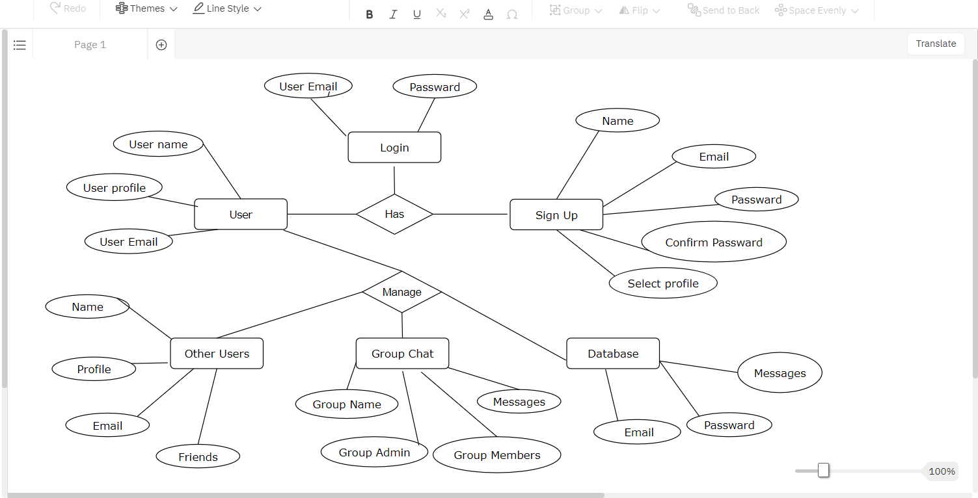
ER Diagram

Slide 9
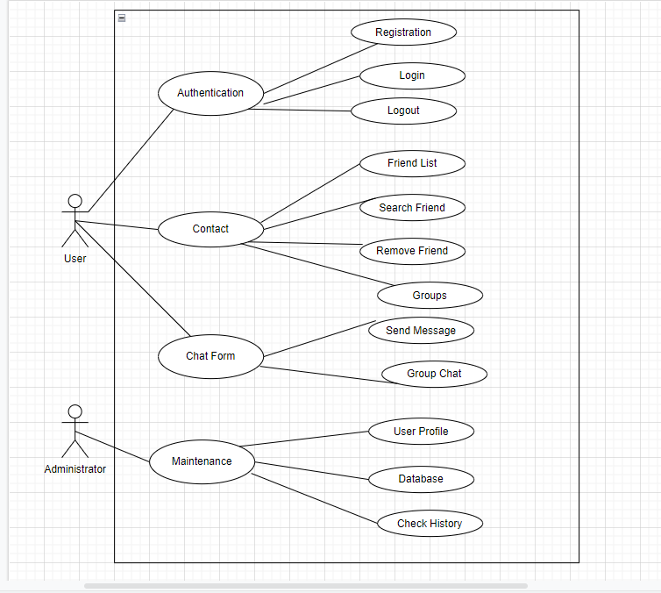
Use Case Diagram

Slide 10
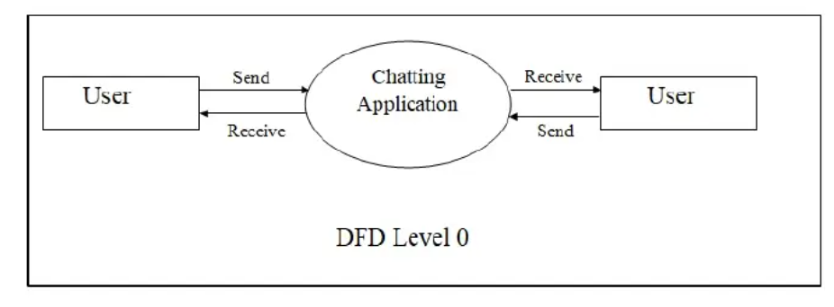
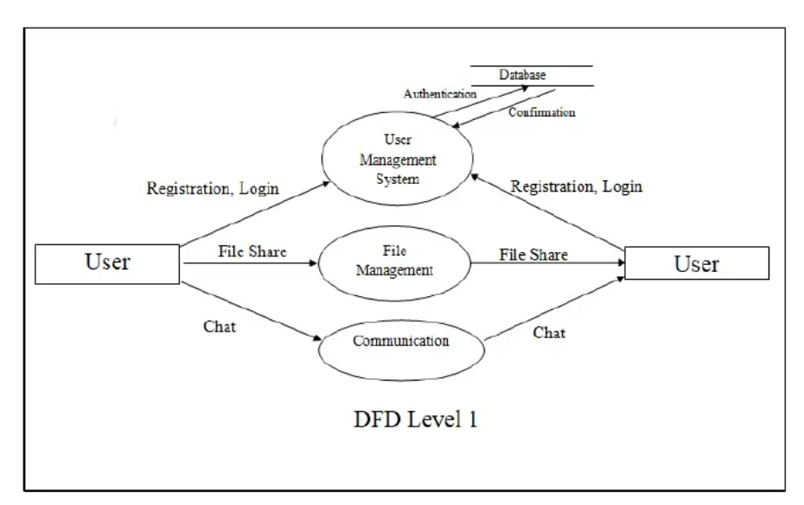
Data flow diagram

Slide 11
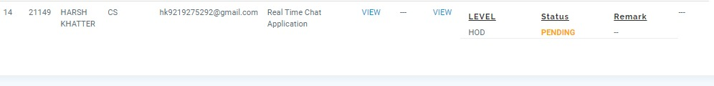
Patent Status

Slide 12
Project Status
100 % project is completed
Research paper submitted
Research paper

Slide 13
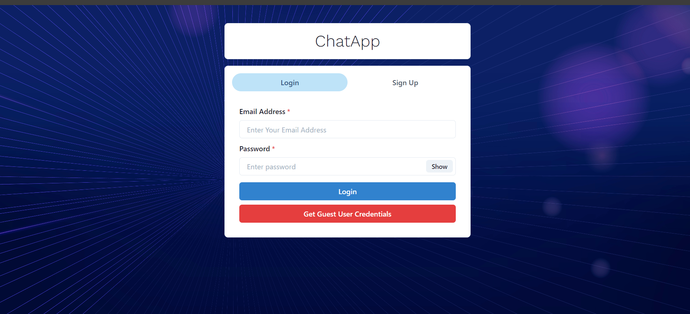
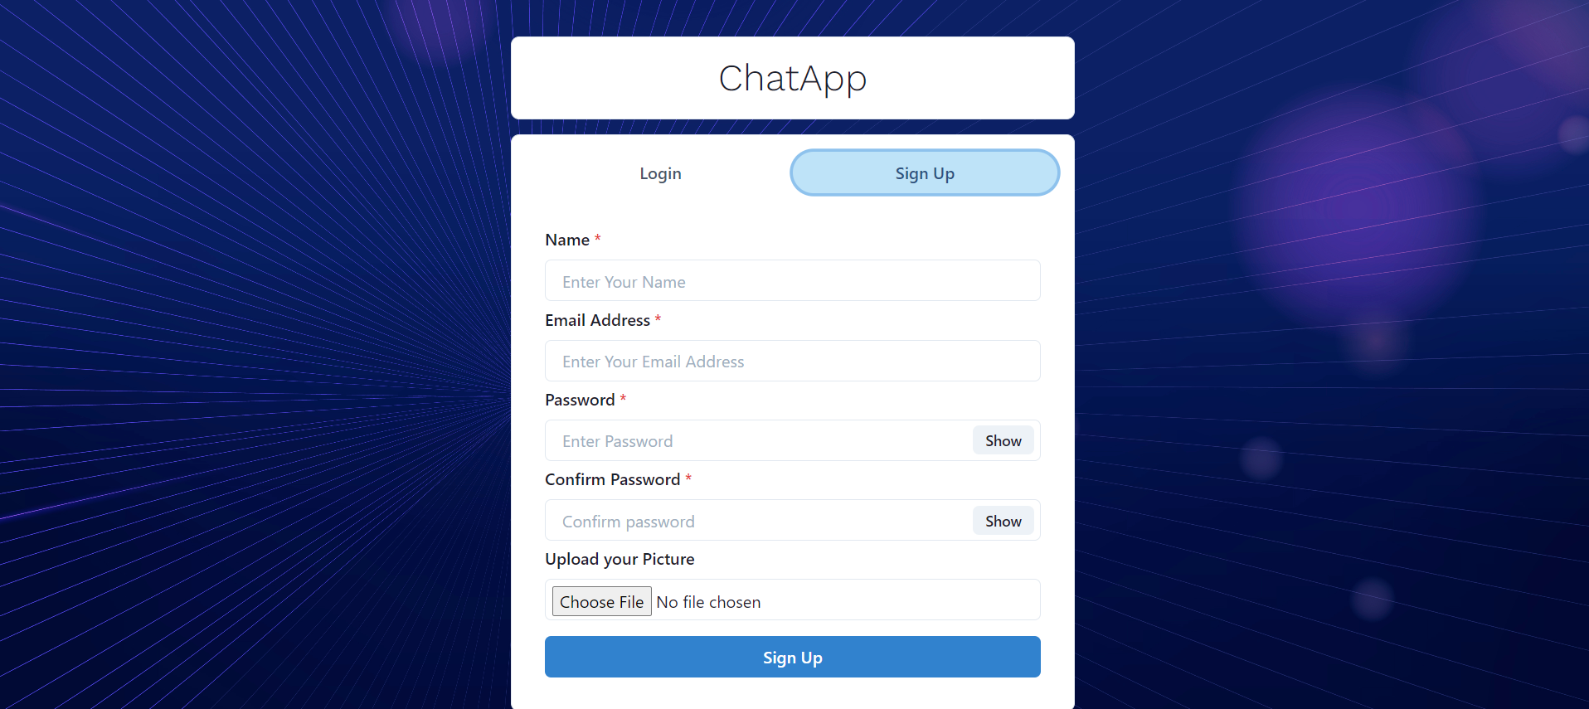
Login , Sign Up page

Slide 14
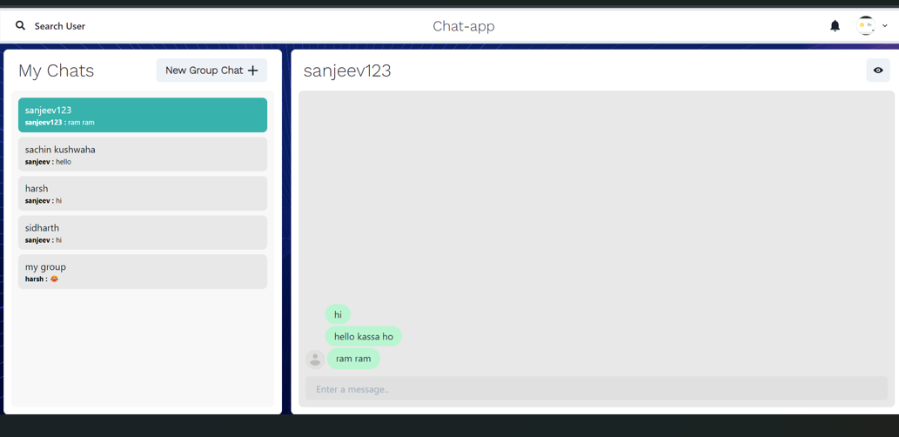
Interface of chat app

Slide 15
Thank You
.

